Slide 1
Digital Marketing Platform for
Gini Fashion
*The name Gini Fashion is used to make the project feel more realistic. The occurrence of any registered trademark | copyrighted entity is completely coincidental

Slide 2

Contents
Project Overview
Our Team
Business Understanding
Data Understanding
Data Preparation
Modeling
Evaluation
Deployment

Slide 3
Project Overview
Mid-term project for the course Distributed & Scalable Data Engineering (DSDE) - 6007-02
Aim - Solve the business problem faced by Gini Fashion
Methodology - CRISP DM

Slide 4



Our Team
Jainam Shah Data Scientist
(Team Lead)
Jagadeesh Yarra
Python Developer
Jeevana Gundapu
Data Engineer
Chandana Cheenepalle
Data Engineer

Slide 5
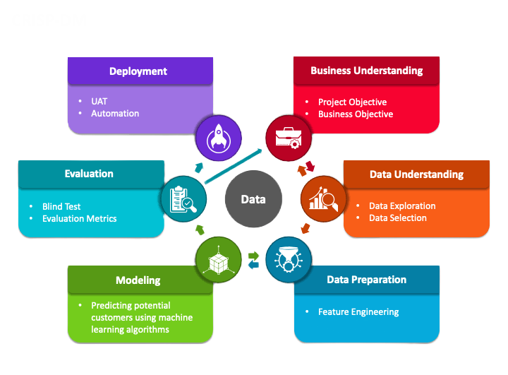
Project Model / Plan
We are following the CRISP-DM model.

Slide 6
Business Understanding
Our client Gini Fashion is an apparel retail chain the caters the clothing needs for Gen-Z’s.
They have their own retail outlets all over the states. They are also available on e-commerce platform like Amazon.
They are planning to launch a digital marketing campaign on one of the popular social media platforms such as Facebook, Youtube, Instagram or Twitter.
We will provide a data driven solution to run their campaign on one of these platform.

Slide 7
The Problem
There are a lot of popular social media platforms to choose from.
Each has its own pros and cons.
Based on the nature of the problem, scale of the target audience, and reachability of the platform, one platform needs to be identified that meets all the needs.

Slide 8
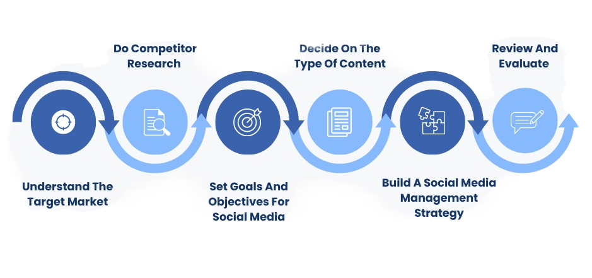
The Approach
* Flow Diagram for selecting appropriate social media channel based on your business

Slide 9
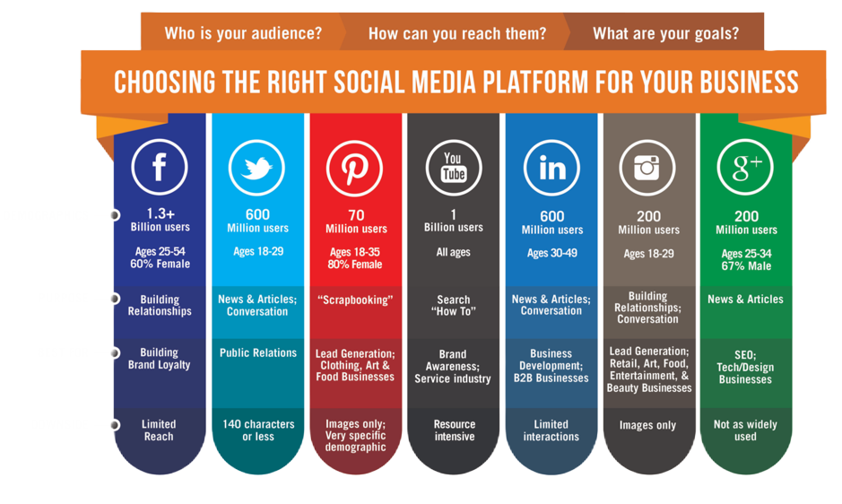
Social Media Platforms Analysis

Slide 10
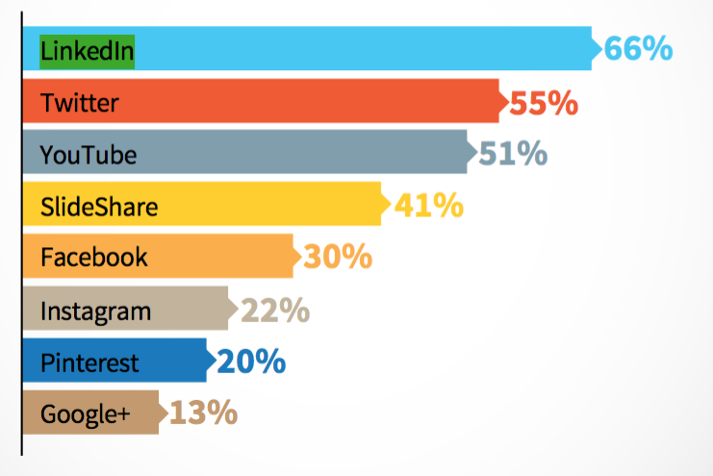
Best ROI for B2C Marketing - Ratings

Slide 11
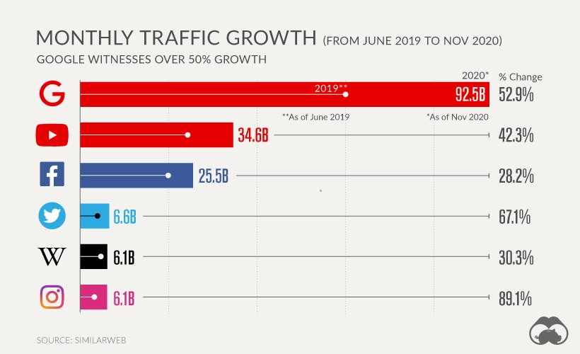
Why Youtube?
Most visited social media platform
Best ROI compared to any other social media platform
Region specific content marketing
Over 1B total users (most on any social media platform)
Highest (42.3%) monthly traffic growth compared to any other social media platform

Slide 12
Data Understanding
DataFrame has 15 columns and data of 3 regions (US, Canada, UK)
“View” column is our target feature.
There are 48 duplicates and 169 null values in the dataset.
Source: https://www.kaggle.com/datasets/datasnaek/youtube-new

Slide 13
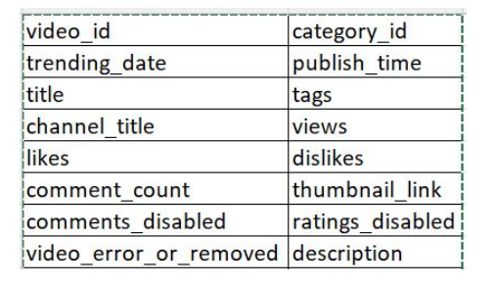
These are the following features that we have in our dataset:

Slide 14
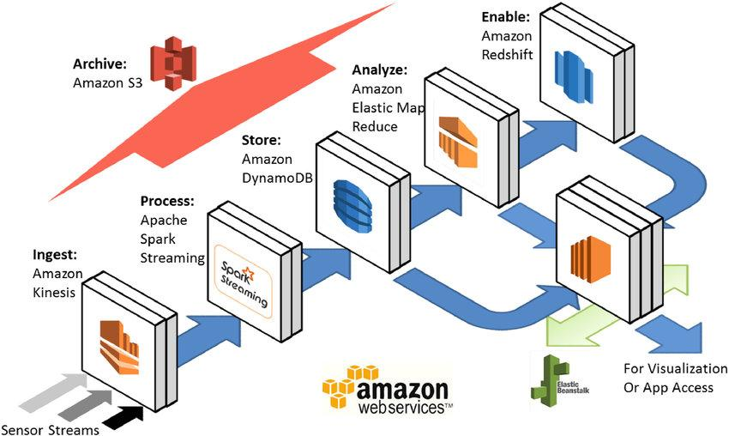
Data Preparation
Amazon S3 Bucket.
Amazon EC2 Instance.
AWS Step Functions.
Consider setting up automated jobs using AWS Lambda, AWS Glue, etc.

Slide 15
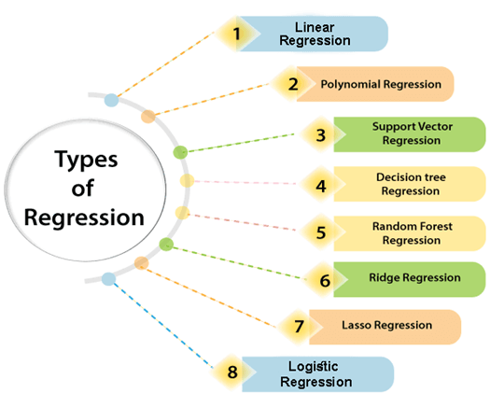
Modeling
The target feature in our dataset can be predicted using a regression algorithm.
Regression is a technique for investigating the relationship between independent variables and outcome.
It's used as a method for predictive modelling in machine learning, in which an algorithm is used to predict continuous outcomes

Slide 16
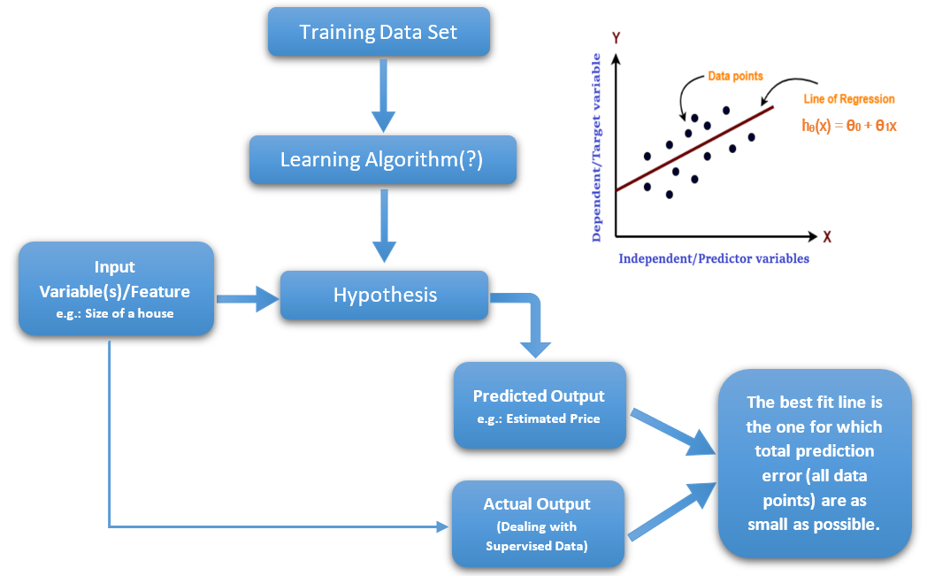
Regression

Slide 17
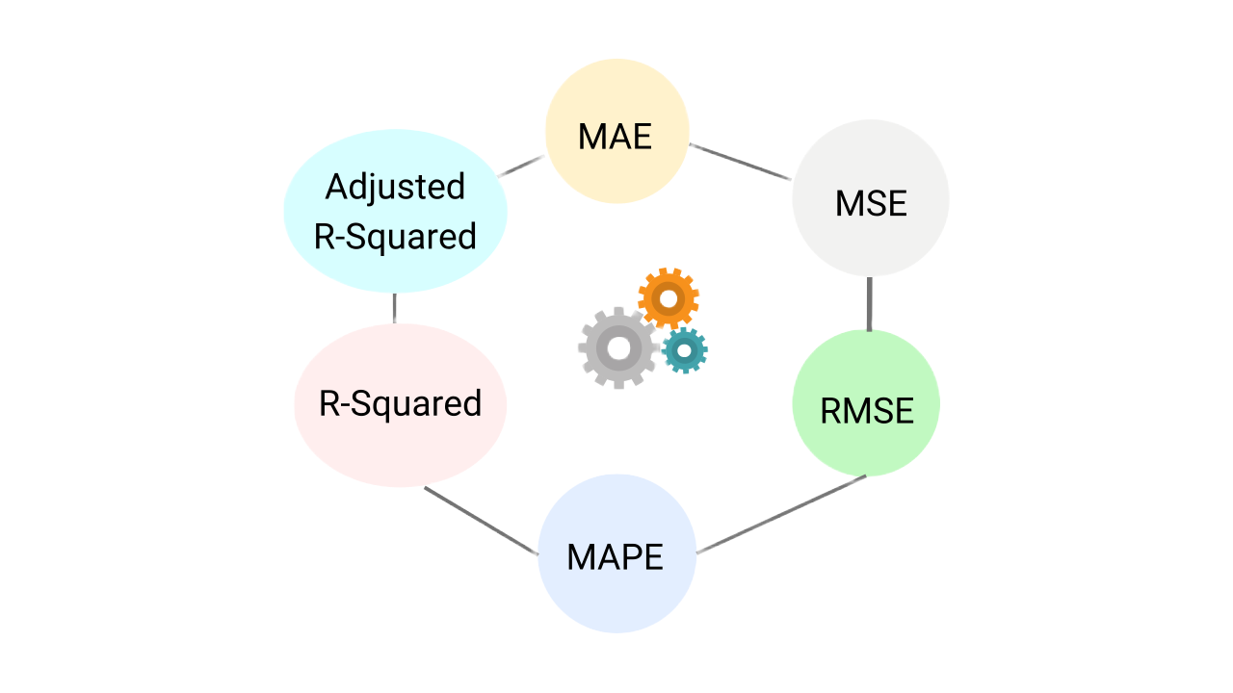
Evaluation
Mean Absolute Error (MAE), Mean Squared Error (MSE), R-Squared, etc. are some of the metrics widely used for evaluating regression models.

Slide 18
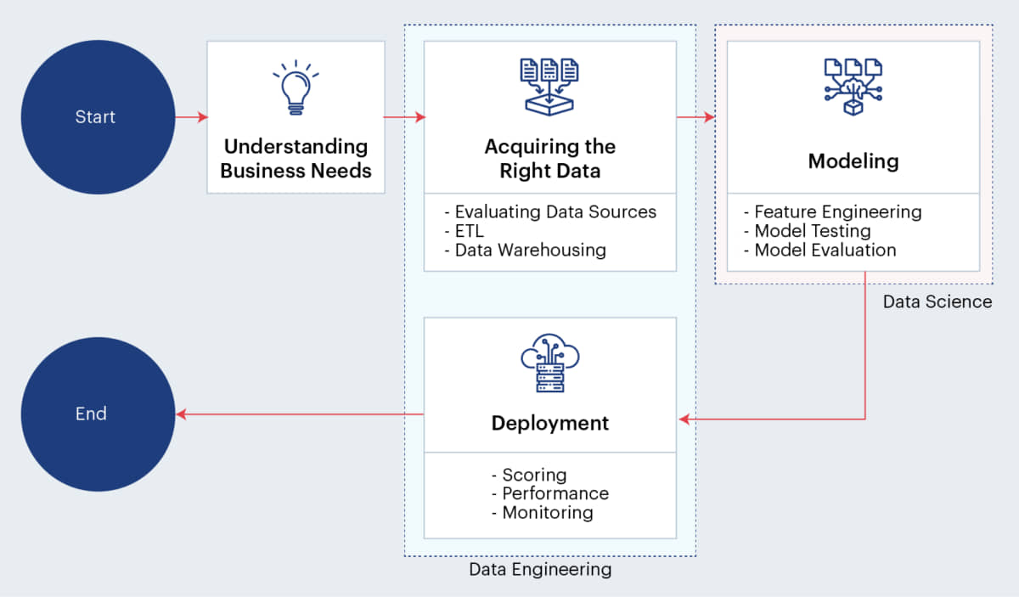
Deployment

Slide 19
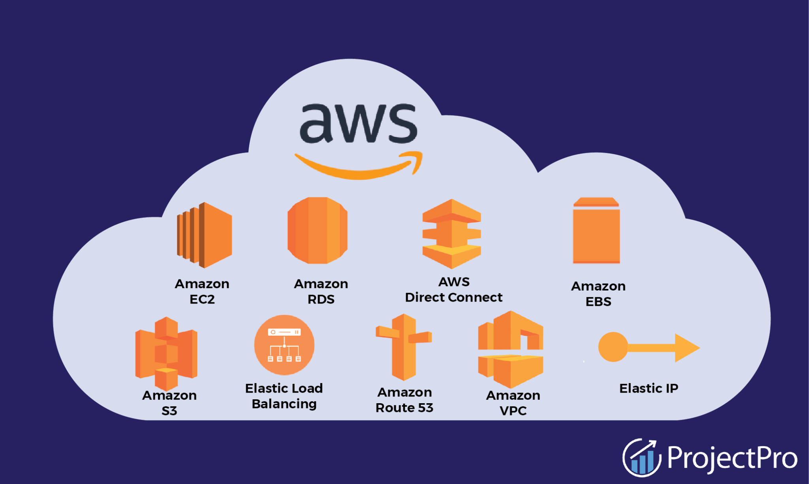
In order to start using a model for practical decision-making, it needs to be effectively deployed into production.
If you cannot reliably get practical insights from your model, then the impact of the model is severely limited.
AWS offers a range of services for Implementing and Maintaining the end to end projects.
So we opted AWS as it’s effective and easy to implement and deploy.

Slide 20
Thank You

